Slide 1

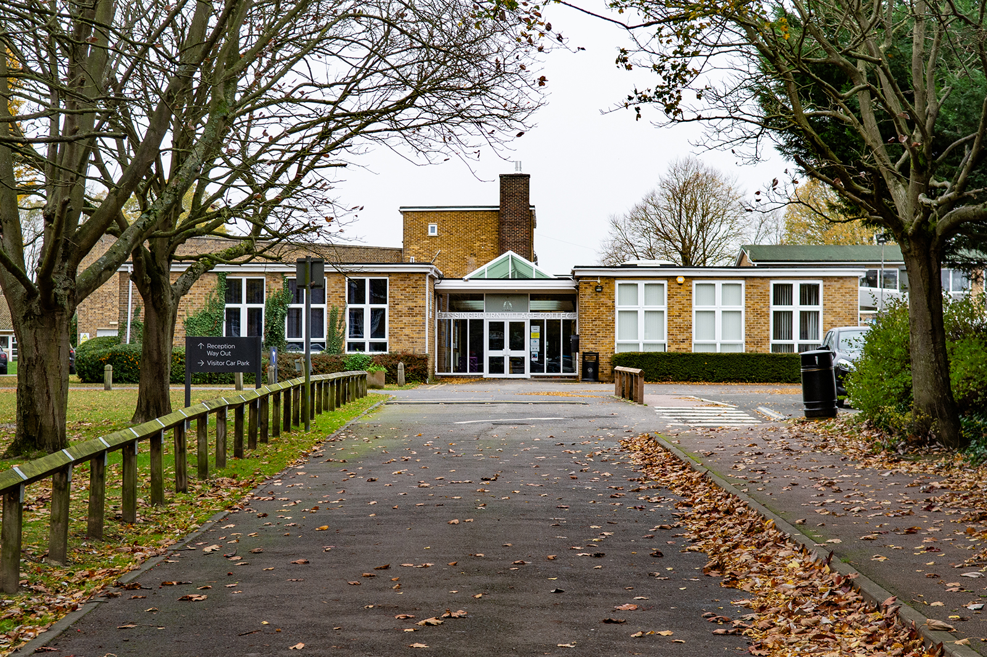
Year 8 Key Stage 4 Options Process
Class of 2029
Notes:
Welcome
Big step in your child’s education since the first chance they have had a choice about their studies.
This evening to provide you with more information about the process, including key dates, different options available and advice. All of this information is also in the booklet given to you earlier.

Slide 2
The Aim of our Curriculum
To provide all students with the opportunity to achieve excellent Key Stage 4 results, which will enable them to pursue their next chosen step in their education.
To support students to develop the skills required for their future studies and eventually the workplace.
To help all students to become respectful, resilient and responsible individuals.
To provide students with a wide range of enrichment opportunities.
Notes:
To provide all students with the opportunity to achieve excellent GCSE results, which will enable them to pursue their next chosen step in their education – be that education, employment or training.
To support students to develop the skills required for their future studies and eventually the workplace – including good study skills, ability to work independently, take on additional responsibilities and good communications skills.
To help all students to become respectful, resilient and responsible individuals.
To provide students with a wide range of enrichment opportunities – this includes external trips and visitors to schholl (eg. Latin students going to Rome, Geography field trips, Berlin trip for History, Theatre trips for English and Drama), but also opportunities not linked to their chosen subjects – sports clubs, drama club, Christmas Show and Dance show, college competitions. We encourage students to participate in such opportunities to ensure that they enjoy a range of positive experiences at BVC that build their confidence and skills. Also participating such opportunities provides them with examples of their positive qualities for their post 16 applications…

Slide 3
Post 16 Progression
All students must remain in full time education or training until they are 18 years old.
At Bassingbourn Village College, for their post 16 studies, most of our students either go to:
Comberton Village College
Long Road Sixth Form College
Hills Road Sixth Form College
Cambridge Regional College
Notes:
Your child must stay in education until they are 18 years old. The purpose of this is to ensure that all young people have acquired the skills and knowledge to enable them to pursue a future career.
For the majority of students this will lead to them attending one of the four colleges displayed, although some of our students do go to other colleges in Bedfordshire and Hertfordshire. Some of our students do decide to follow the route of apprenticeships as well. No matter the option our students choose, we support them when applying for their post 16 choices in Year 11.

Slide 4
Compulsory KS4 Curriculum
All students must study the following compulsory GCSE subjects:
English Language 1 GCSE
English Literature 1 GCSE
Mathematics 1 GCSE
Science 2 or 3 GCSEs
Additionally, students will also have lessons in:
Physical Education
Personal Development, including Careers Development
Notes:
Your child must stay in education until they are 18 years old. The purpose of this is to ensure that all young people have acquired the skills and knowledge to enable them to pursue a future career.
For the majority of students this will lead to them attending one of the four colleges displayed, although some of our students do go to other colleges in Bedfordshire and Hertfordshire. Some of our students do decide to follow the route of apprenticeships as well. No matter the option our students choose, we support them when applying for their post 16 choices in Year 11.

Slide 5
Option Blocks
We want students to have a wide range of choice, which allows each student to choose a suitable pathway for their future study and careers plans.
Students will have the option to study vocational courses, the EBacc or a combination of the two.
The blocks have been created with knowledge of combinations and historical patterns.
Notes:
Great time and consideration is taken to create the option blocks.
We want students to have a wide range of choice, which allows each student to choose a suitable pathway for their future study and careers plans.
The blocks have been created with knowledge of combinations and historical patterns. We have also used the feedback provided by Year 8 about their initial preferences from earlier this term to create the different combinations in the option blocks to ensure as many students as possible can study the options they wish to select.
Students will have the option to study vocational courses, the EBacc or a combination of the two.
Despite taking all of the above into consideration, some students unfortunately will be disappointed. We are sorry for this, but we are limited by the timetable as well.
Over subscription will be tackled through the order of preference and the ability to put students in reserve subjects.
If a course is deemed not viable, which could be because not enough students choose it, a teachers leaves or any other reason, the students who have opted for this subject will have further meetings to discuss their choices.

Slide 6
Option Blocks
Despite taking all of the above into consideration, some students unfortunately will be disappointed.
Over subscription will be tackled through the order of preference and the ability to put students in reserve subjects.
If a course is deemed not viable, the students who have opted for this subject will have a meeting to discuss the next steps.
Notes:
Great time and consideration is taken to create the option blocks.
We want students to have a wide range of choice, which allows each student to choose a suitable pathway for their future study and careers plans.
The blocks have been created with knowledge of combinations and historical patterns. We have also used the feedback provided by Year 8 about their initial preferences from earlier this term to create the different combinations in the option blocks to ensure as many students as possible can study the options they wish to select.
Students will have the option to study vocational courses, the EBacc or a combination of the two.
Despite taking all of the above into consideration, some students unfortunately will be disappointed. We are sorry for this, but we are limited by the timetable as well.
Over subscription will be tackled through the order of preference and the ability to put students in reserve subjects.
If a course is deemed not viable, which could be because not enough students choose it, a teachers leaves or any other reason, the students who have opted for this subject will have further meetings to discuss their choices.

Slide 7
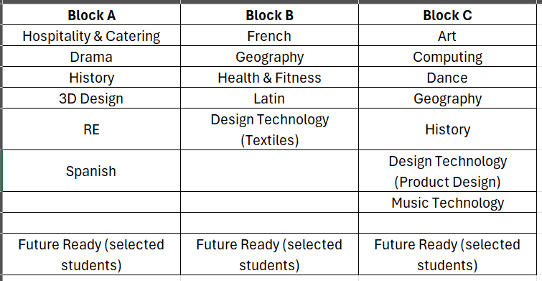
Option Blocks
Notes:
Can not study both Art and 3D Design, since they are different options of the same subject and therefore cover the same content. Art focuses more on the skills of drawing and painting, whilst 3DDesgn focuses on the 3D aspect.
Students CANNOT choose both D&T(Textiles) and D&T (Product Design) as they are just different parts/options of the same course.
However, on the options form students can put one of these options as their first choice and the other as a reserve choice. (e.g. They could put D&T Textiles as a first choice for Block B and Product Design as a reserve choice for Block C.)

Slide 8
Option Subjects
Students will study between eight and nine qualification courses at Key Stage 4 and three of these will be subjects they opt to study.
They must choose one option from each of the three blocks and one reserve choice from each block.
You must put these six choices into a preference order on the form.
The options form will not submit without these six choices being completed.
Notes:
The majority of the courses we offer are GCSEs, which is the more traditional qualification at Key Stage 4, but we do offer three courses, which are not GCSEs but rather vocational courses.
Vocational courses are work related qualifications suitable for a wide range of students, built to accommodate the needs of employers and allow progression to university. They provide a more practical, real-world approach to learning alongside a key theoretical background. The combination of theory and practical lessons makes these courses more suitable for some of our students.
I would like to stress that vocational courses are considered the equivalent to GCSEs by post 16 colleges. However, some colleges do limit the number of vocational courses a student can have as qualifications if they apply to them and therefore I would strongly advise you to check the websites of the colleges you may apply to in Year 11.

Slide 9
GCSE vs. Vocational Courses
Vocational courses
Health and Fitness
Hospitality and Catering
Music Technology
Notes:
The majority of the courses we offer are GCSEs, which is the more traditional qualification at Key Stage 4, but we do offer three courses, which are not GCSEs but rather vocational courses.
Vocational courses are work related qualifications suitable for a wide range of students, built to accommodate the needs of employers and allow progression to university. They provide a more practical, real-world approach to learning alongside a key theoretical background. The combination of theory and practical lessons makes these courses more suitable for some of our students.
I would like to stress that vocational courses are considered the equivalent to GCSEs by post 16 colleges. However, some colleges do limit the number of vocational courses a student can have as qualifications if they apply to them and therefore I would strongly advise you to check the websites of the colleges you may apply to in Year 11.

Slide 10
GCSE vs. Vocational Courses
GCSE | Vocational Courses
Graded 9-1 | Graded Level 1, Level 2, Pass, Merit, Distinction, Distinction*
Mainly linear – most are assessed 100% by examinations at the end of Year 11. | Combination of ongoing assessment and external examinations.
Subjects that require a demonstration of skills (e.g. Art, Drama, D&T subjects) have non-examination assessment worth 60% | External exams are worth up to 40%
 | Learning through hands-on experiences
Notes:
The majority of the courses we offer are GCSEs, which is the more traditional qualification at Key Stage 4, but we do offer three courses, which are not GCSEs but rather vocational courses.
Vocational courses are work related qualifications suitable for a wide range of students, built to accommodate the needs of employers and allow progression to university. They provide a more practical, real-world approach to learning alongside a key theoretical background. The combination of theory and practical lessons makes these courses more suitable for some of our students.
I would like to stress that vocational courses are considered the equivalent to GCSEs by post 16 colleges. However, some colleges do limit the number of vocational courses a student can have as qualifications if they apply to them and therefore I would strongly advise you to check the websites of the colleges you may apply to in Year 11.

Slide 11
GCSE vs. Vocational Courses
GCSE Grades | Vocational Course Grades
9 | Level 2 Distinction*
8
7 | Level 2 Distinction
6 | Level 2 Merit
5 | Level 2 Pass
4
3 | Level 1 Distinction*
 | Level 1 Distinction
2 | Level 1 Merit
1 | Level 1 Pass
Notes:
The English Baccalaureate is a set of subjects at GCSE that keeps young people’s options open for further study and future careers. It is made up of the subjects which are considered essential to many degrees and open up lots of doors.
A study by the UCL Institute of Education shows that studying subjects included in the EBacc provides students with greater opportunities in further education and increases the likelihood that a pupil will stay on in full-time education. Sutton Trust research reveals that studying the EBacc can help improve a young person’s performance in English and Maths.
For some students they may want to acquire the EBacc because it will support them to achieve a place in one of the best universities and open career opportunities. However, if a student does not study the subjects to acquire the EBacc it does not prevent them from going to university or bar them from applying to any university or career.
At Bassingbourn Village College we do recognise that this may not be the most appropriate pathway for some of our students and it is the choice of students and their parents as to whether they wish to complete the subjects specified to acquire the EBacc.

Slide 12
The EBacc
The EBacc is awarded to students who have studied specific subjects at Key Stage 4, which are considered essential to many degrees and provides students with a broad knowledge that many employers require.
These subjects are:
English Language and Literature
Mathematics
Sciences
Geography or History
A Language
To achieve the EBACC students need to achieve a grade 5 or above in each of
these subjects.
Notes:
The English Baccalaureate is a set of subjects at GCSE that keeps young people’s options open for further study and future careers. It is made up of the subjects which are considered essential to many degrees and open up lots of doors.
A study by the UCL Institute of Education shows that studying subjects included in the EBacc provides students with greater opportunities in further education and increases the likelihood that a pupil will stay on in full-time education. Sutton Trust research reveals that studying the EBacc can help improve a young person’s performance in English and Maths.
For some students they may want to acquire the EBacc because it will support them to achieve a place in one of the best universities and open career opportunities. However, if a student does not study the subjects to acquire the EBacc it does not prevent them from going to university or bar them from applying to any university or career.
At Bassingbourn Village College we do recognise that this may not be the most appropriate pathway for some of our students and it is the choice of students and their parents as to whether they wish to complete the subjects specified to acquire the EBacc.

Slide 13
Future ready
There are some students that we believe would be better suited to focusing on 2, rather than 3 options.
For their third option block, they would pick future ready. This will consist of a variety of short courses, alongside additional maths and literacy skills. This will be tailored dependent on the group of students.
These students will be identified, and parents/carers will be spoken to prior to this decision being made.

Slide 14
How should I choose my option subjects?
Access all the information available to you about the subjects – the options booklet, the subject talks on Google Classrooms, speak to your teachers and mentors.
Consider your future plans – what qualifications do you require?
Consider whether you wish to acquire the EBacc.
Think about how well you cope with preparing for examinations and the pressure of them. Do you think you would benefit from completing vocational courses that offer ongoing assessment?
Think about the combination of subjects and the workload of these.
Think about what subjects you enjoy and you are good at.
Talk through your choices with your family, staff at school and the older students in your mentor group.
Notes:
Talk through the advice on the page and direct them to their booklet.
Remind them of the importance of not choosing based on friends or teachers they like.

Slide 15
Support Available
The options booklet
Taster sessions in lessons
Your teachers and mentor
Guidance Meetings
This powerpoint, which will be available on the school website
Unifrog
UCAS website

Slide 16
Speaking to the Subject Leads Tonight
Scan through the information in the booklet and ask for clarification about any questions you have.
The format of assessments e.g. essays, portfolio, etc.
The exceptions regarding homework.
The skills required to be successful in their subject.
Look at the example of work produced by current and past students.
If a vocational course, discuss the coursework assessments – how many hours of work is this? What do students need to do to be successful?
If Key Stage 4 students are present for the subject, ask them what they have enjoyed and what has been challenging?
Notes:
Yesterday, Year 8 during their curriculum day created a list of questions to ask the subject leads today and hopefully all the students have brought these along tonight to use.
Talk through bullet points on screen.

Slide 17
Key Dates
Wednesday 29th April 2026: Options form will be made available to students on Google Classrooms.
Monday 20th April - Friday 1st May 2026: Each student will have a guidance meeting.
Thursday 7th May 2026, 3.20pm: Options form must be submitted by this date.
By July 2026: Provisional allocation of Key Stage 4 courses to Year 8 students.
Notes:
Options from available – give students time to think carefully and reflect on their choices and not rush to complete their form. It gives them time to discuss their choices with parents, mentors, staff at school, guidance meetings and older members of mentor group. It is not first come first served with the forms.
Guidance Meetings – discuss options with AL or member of SLT to check their reasons are good for their choices and may also look at their recent DP to discuss any other suitable subjects for them.
Submission of forms – must be completed and submitted by this date. This is the responsibility of the student to ensure this is completed. If they are not completed by the deadline, they will be processed last and this may impact on whether they get their option choices.
Provisional allocation of Key Stage 4 courses to Year 8 students – only provisional due to staffing changes – if someone leaves who is the only teacher who teaches this subject and we can not replace them we may have to remove the course, this would be a last resort.

Slide 18
Completing the Google Options Form
Issued on Google Classrooms on Wednesday 29th April 2026 .
Students must choose two options in each block – a first choice and a reserve choice.
It is not first come, first served.
The order of preference is important because it will be used if a course is oversubscribed.
Notes:
Must be completed by the deadline.
Must choose 1 first choice per option box and 1 reserve per option block. Meaning that you will have chosen six different subjects in total.
You must complete your order of preference and out them in the correct order – you don’t want to miss out on studying your first choice because you have not given proper thought to your preferences or tried to out smart the system.
Check the email confirmation carefully to ensure it is correct and if it is not come see me.
Any questions about the process, you can email myself or speak to a member of staff after this presentation.

Slide 19
Completing the Google Options Form
Students need to tick a box to say that their parents agree.
Students will receive an email copy of the form they have submitted.
It must be submitted by 3.20pm on Thursday 7th May 2026 on Google Classrooms.
Any form submitted after this date will be processed after the other forms and therefore this may impact on whether a student acquires their preferred choices.
Notes:
Must be completed by the deadline.
Must choose 1 first choice per option box and 1 reserve per option block. Meaning that you will have chosen six different subjects in total.
You must complete your order of preference and out them in the correct order – you don’t want to miss out on studying your first choice because you have not given proper thought to your preferences or tried to out smart the system.
Check the email confirmation carefully to ensure it is correct and if it is not come see me.
Any questions about the process, you can email myself or speak to a member of staff after this presentation.

Slide 20
Rooms for Tonight
Room 1
Design & Technology (Product Design)
Design & Technology (Textiles)
3D Design
Health & Fitness
Hospitality & Catering
English (Language and Literature)
Room 3
History
Geography
Religious Studies
Drama
Music Technology
Dance
Science
Room 2
Latin
Spanish
French
Art
Computing Science
Maths
Personal Development

