Slide 1
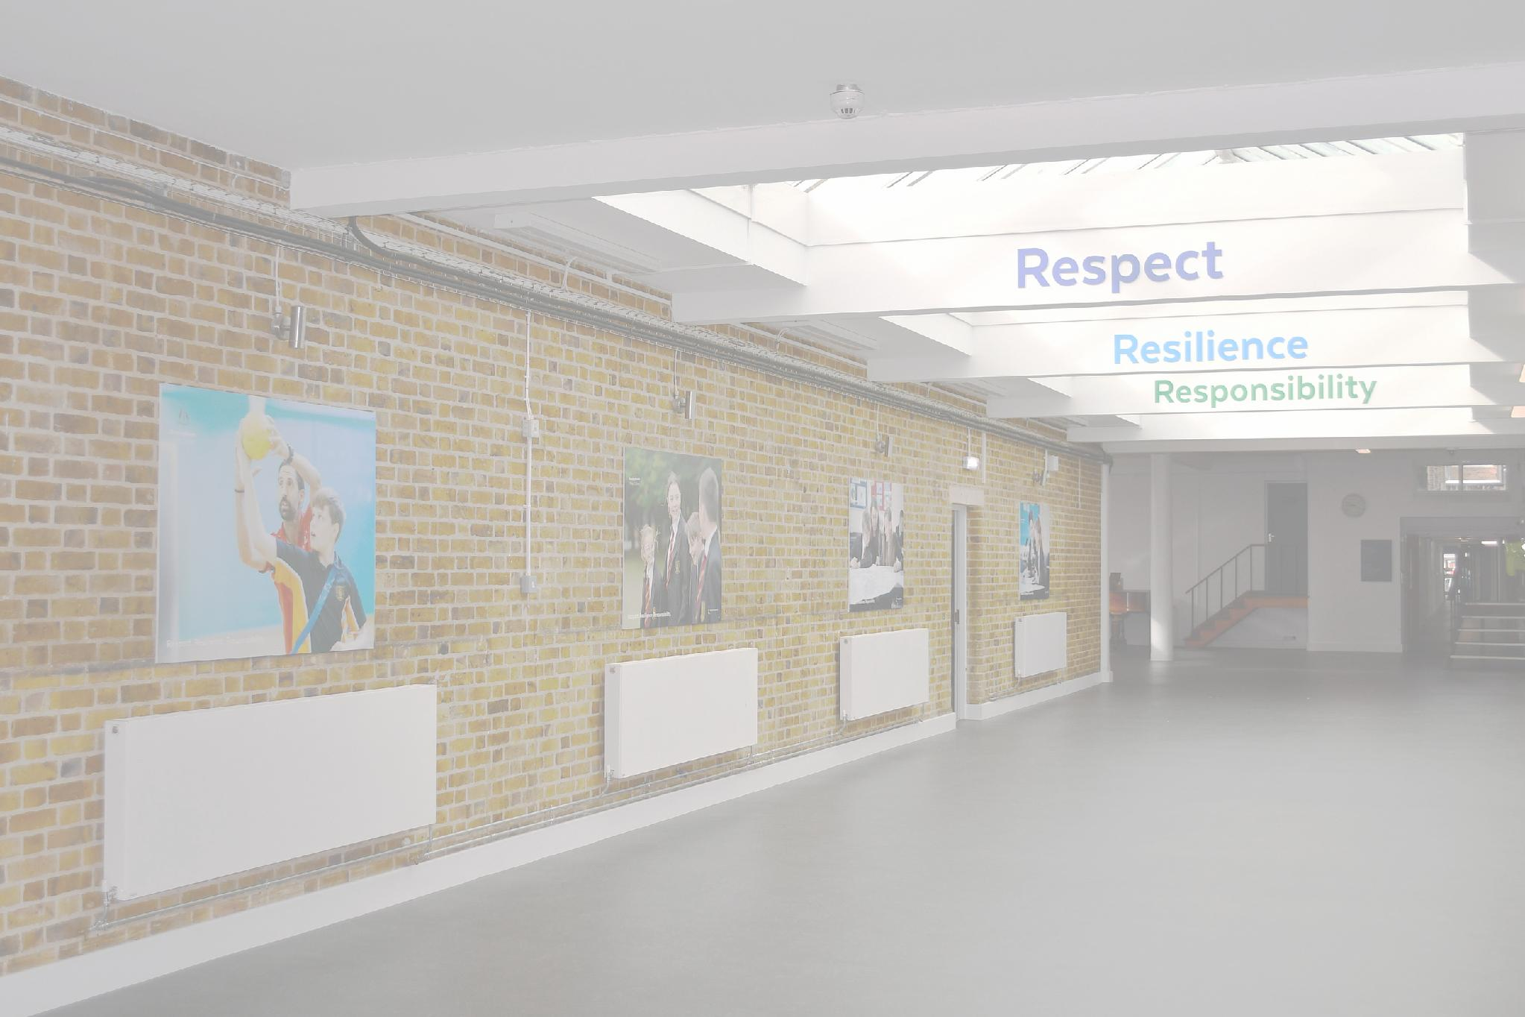



Respect
Resilience
Responsibility
Welcome to
Bassingbourn Village College

Slide 2

Respect
Resilience
Responsibility
We are Part of the Anglian Learning Trust
Anglian Learning Trust Values:

Slide 3

Respect
Resilience
Responsibility
Our Core Values at Bassingbourn Village College
These are the life skills that we nurture:
  Respect
  Resilience
  Responsibility

Slide 4
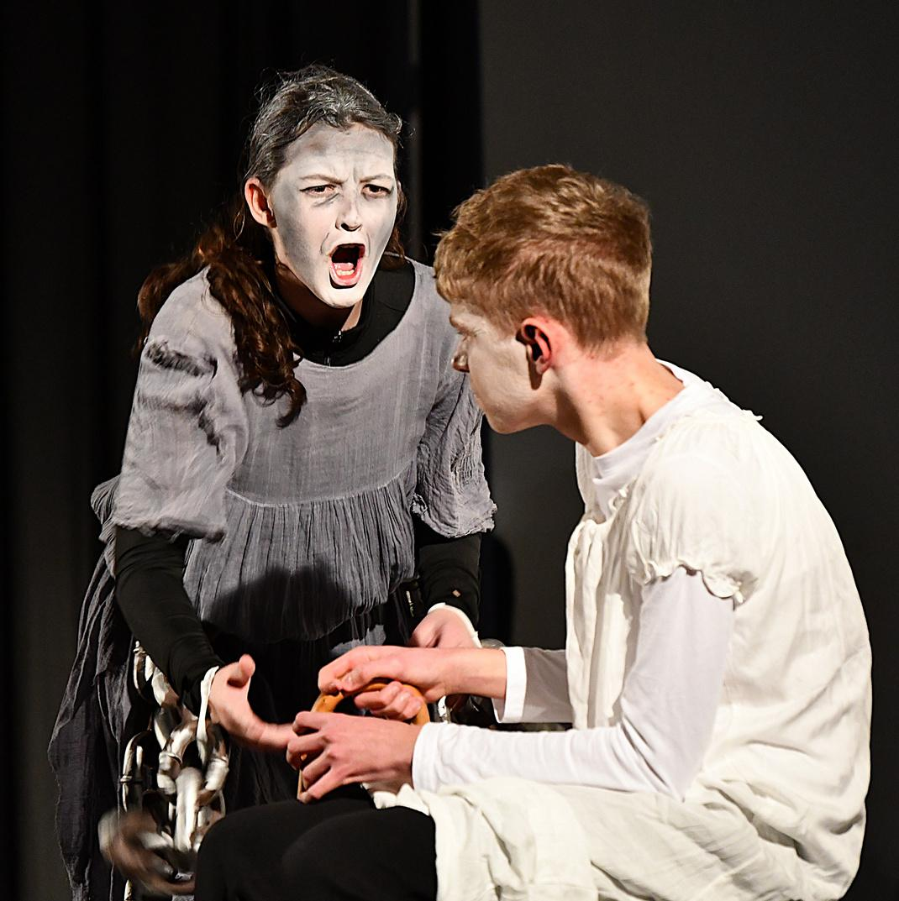
Respect
Resilience
Responsibility
Extending the Boundaries of Learning and Extra-Curricular
We encourage our students to explore their ideas and individuality. To support this, we run an array of extra-curricular clubs in PE, Dance, Creative Arts, Music, Drama, English, Geography, Computing and Science.

Slide 5
Respect
Resilience
Responsibility
Some Useful People to know
  Mr Stoneham - Principal
  Mr Brock - Deputy Principal
  Mr Hughes - Deputy Principal
  Ms Hields - Assistant Principal
  Miss Chalmers - Assistant Principal
  Ms Manley - Assistant Principal
  Ms Clover - Assistant Principal
  Mrs Constantinides & Mrs Eavis - Student Support Workers (SSW)
  Mrs Sadler - Inclusion & Pastoral Intervention Manager
  Mrs Parker - Deputy SENDCo
  Mrs Lambert & Mrs Little - Administrative Assistants

Slide 6

Respect
Resilience
Responsibility
The School Day
Mentor Time | 08:55 - 09:15
Lesson 1a | 09:15 - 10:05
Lesson 1b | 10:05 - 10:55
Break | 10:55 - 11:15
Lesson 2a | 11:15 - 12:05
Lesson 2b | 12:05 - 12:55
Lunch | 12:55 - 13:40
Lesson 3a | 13:40 - 14:30
Lesson 3b | 14:30 - 15:20
Mentors will check uniform, equipment, phones, and make sure students are ‘learning’ ready. They will also provide reminders about events and deliver a pastoral curriculum.

Slide 7




Respect
Resilience
Responsibility
Welcome to our house
Artemis House
Hercules House
Athena House
Atalanta House

Slide 8
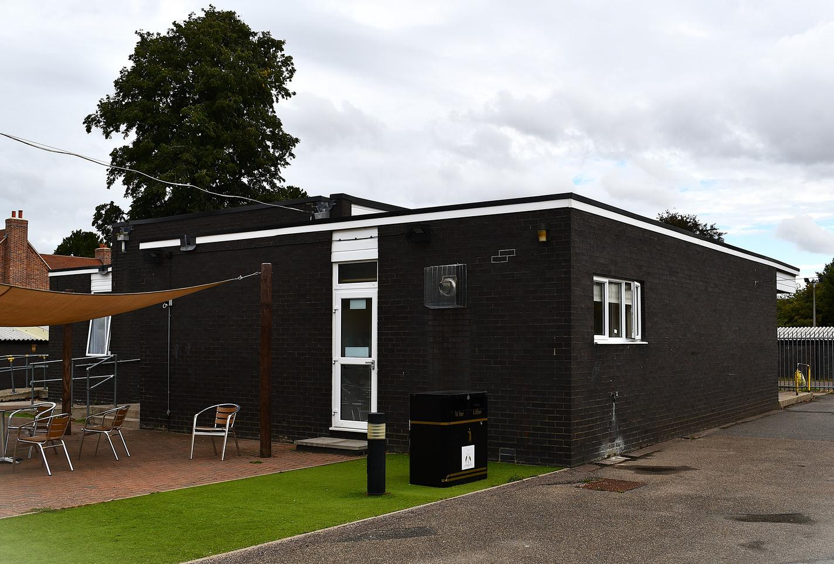
Respect
Resilience
Responsibility
Student Services
Student Services are a source of general information and support and includes:
  Pastoral Support
  Behaviour Support
  Interventions e.g. ELSA
  Uniform
  Reflect
  Base for the SSW’s & AL’s

Slide 9

Respect
Resilience
Responsibility
Vertical Mentoring
  Peer to Peer support: Breaks down barriers between year groups.
  Develops interpersonal and cross-age skills: practices important skills of teamwork, leadership, creativity, listening and speaking and problem solving.
  School within a school, where everyone is known.
  Each House has its own identity and a sense of belonging.
  Introduces healthy competition (rewards for participation) and merits go towards House competitions.
  All students will understand their journey through school and the different stages of their development.

Slide 10

Respect
Resilience
Responsibility
Reminders for September...
  Blazers and ties must be worn - adjustments are made for the summer term
  Jumpers can be worn UNDER blazers, but not in place of. They MUST be black V-neck only, NOT a sweatshirt, hoodie, zipper, nor round necked.
  Skirts MUST be tailored, pleated, straight and non-stretch, and MUST be at / or below knee length.
  Shirts must remain tucked in.
  Shoes MUST be black with no other colour visible. Leather / Leather style uppers, NOT canvas, or fabric. Heels should not be more than 3cm high for health and safety reasons. Trainers can be worn but MUST be 100% leather / faux leather upper, no fabric.
  Piercings are restricted to one, simple plain set of ear lobe studs.
  No jewellery.
  Hairstyles should be of natural colour and no extreme styles.

Slide 11

Respect
Resilience
Responsibility
Reminders for September...
  Students do not have access to their phones during the school day.
  On arrival phones are to be placed and locked inside the student’s allocated ‘HUSH’ pouch for the duration of the day.
  If a student is seen with a phone out during the school day it will be confiscated and the student given a consequence. .
  If a student needs to contact home, they should make their way to reception where the administrative team will call on their behalf.

Slide 12
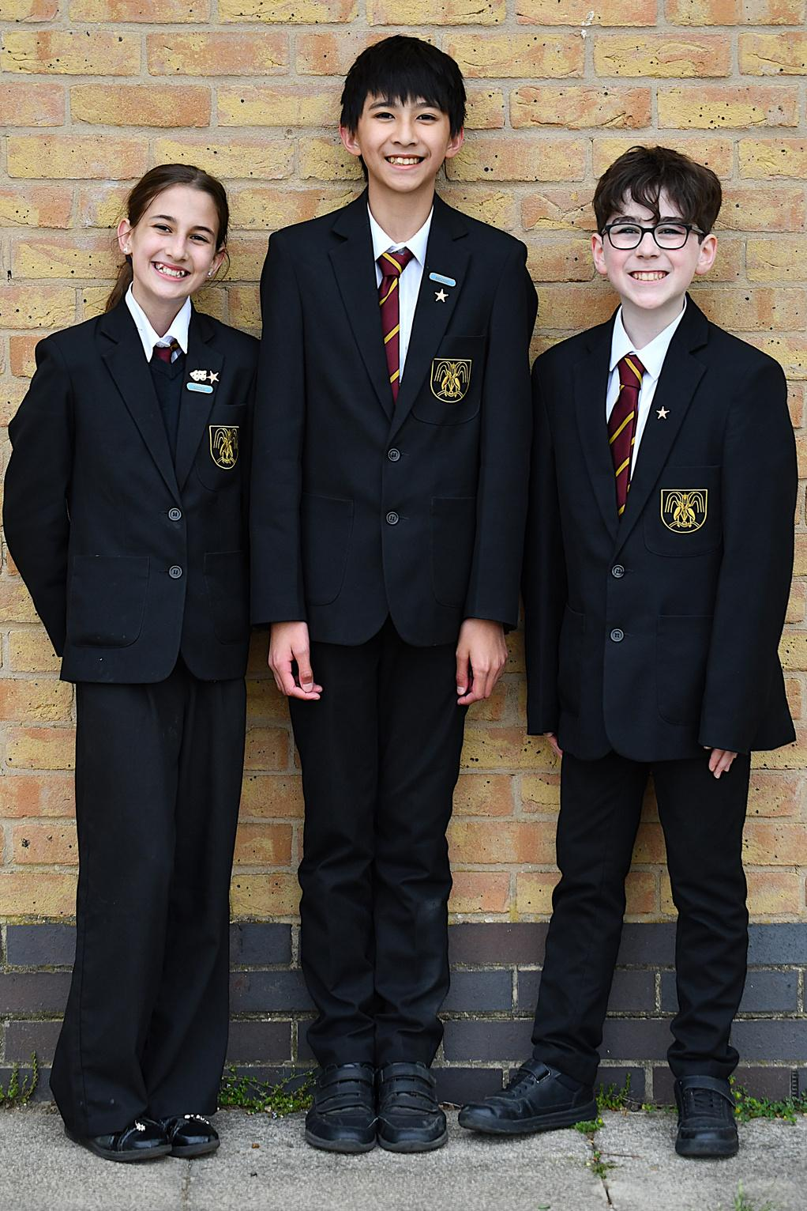
Respect
Resilience
Responsibility
Reminders for September...
  If a student leaves a lesson, for any reason, they must carry a yellow lanyard which will be issued to them by a staff member.
  Students must use the toilet at break and lunch time, only students with a pass can go at other times. Time away from lessons is ‘lost learning’. Please note, that if a student must go to the toilet, they will be allowed, but this will be monitored.
  Students must fill water bottles at break and lunch time from one of the hydration stations.

Slide 13
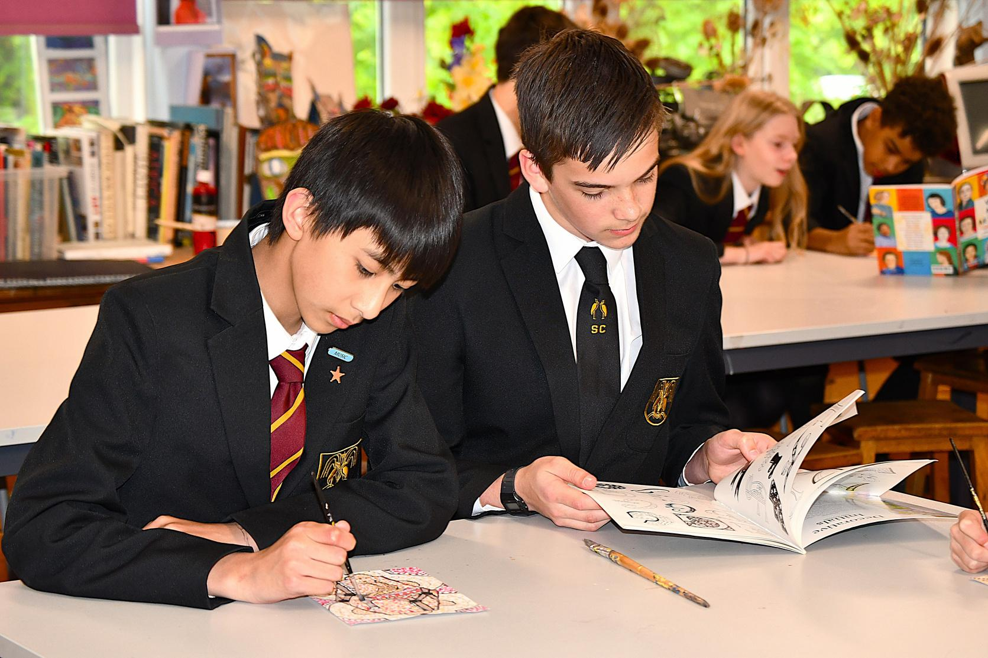
Respect
Resilience
Responsibility
Reminders for September...
September 3rd – An exclusive day for Year 7 & 11. Students will discover their mentor group; be given their timetable and be introduced to some of their new teachers and cohort.
Students will have access to the school canteen and will be able to select a variety of hot or cold food options. Alternatively, students are welcome to bring a packed lunch.

Slide 14
Respect
Resilience
Responsibility
Attendance
If your child is unable to come to school we ask that you report this to us by 8:15am on 01763 242344, or email absence@bassingbournvc.org. We do ask that you call or email EVERY day that your child is absent for safeguarding reasons.
Students should arrive at school by 08:50am to ensure they are in Mentor Time for 08:55am. Students that arrive after the register has been completed will be marked as absent and unauthorised.
If your child’s attendance falls below 95% you will automatically receive a letter raising a concern and advising you that their attendance is being monitored.

Slide 15
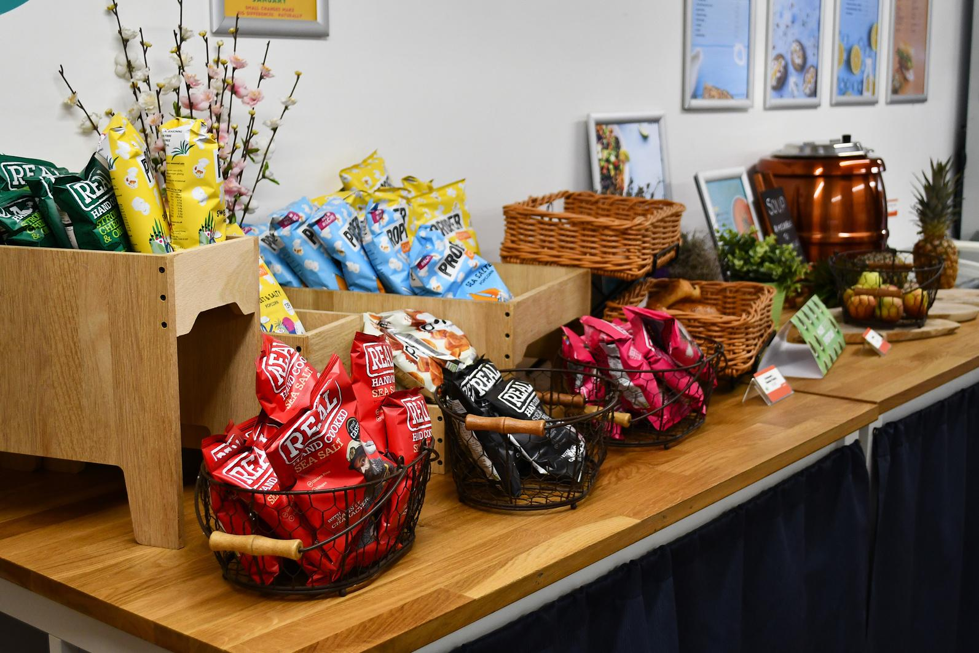
Respect
Resilience
Responsibility
Cashless Catering / Lunchtimes
Innovate is our catering company, providing a variety of healthy and tasty meals every day as well as a wide selection of “grab and go” items including baguettes, paninis, burritos and salads.
The menu follows a similar weekly pattern, so students know what to expect.

Slide 16
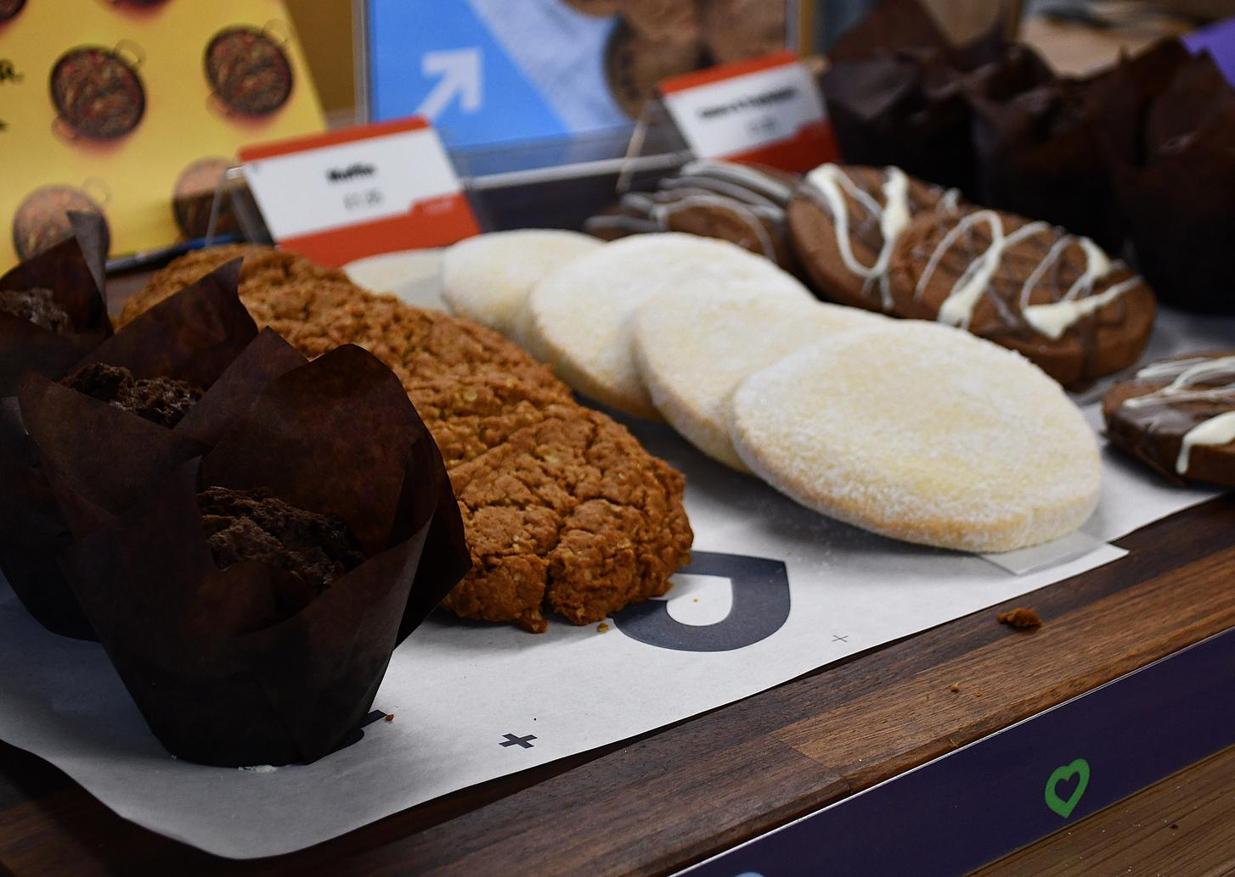
Respect
Resilience
Responsibility
Cashless Catering / Lunchtimes
The most popular meal deal is the Blue Dot meal which allows students to choose any 4 items from selected rolls, sandwiches, drinks, cakes, fruit bags and much more!
Innovate operate a cashless till with money payable by parents/carers online in advance.
Students are not able to purchase food unless their accounts are in credit.

Slide 17
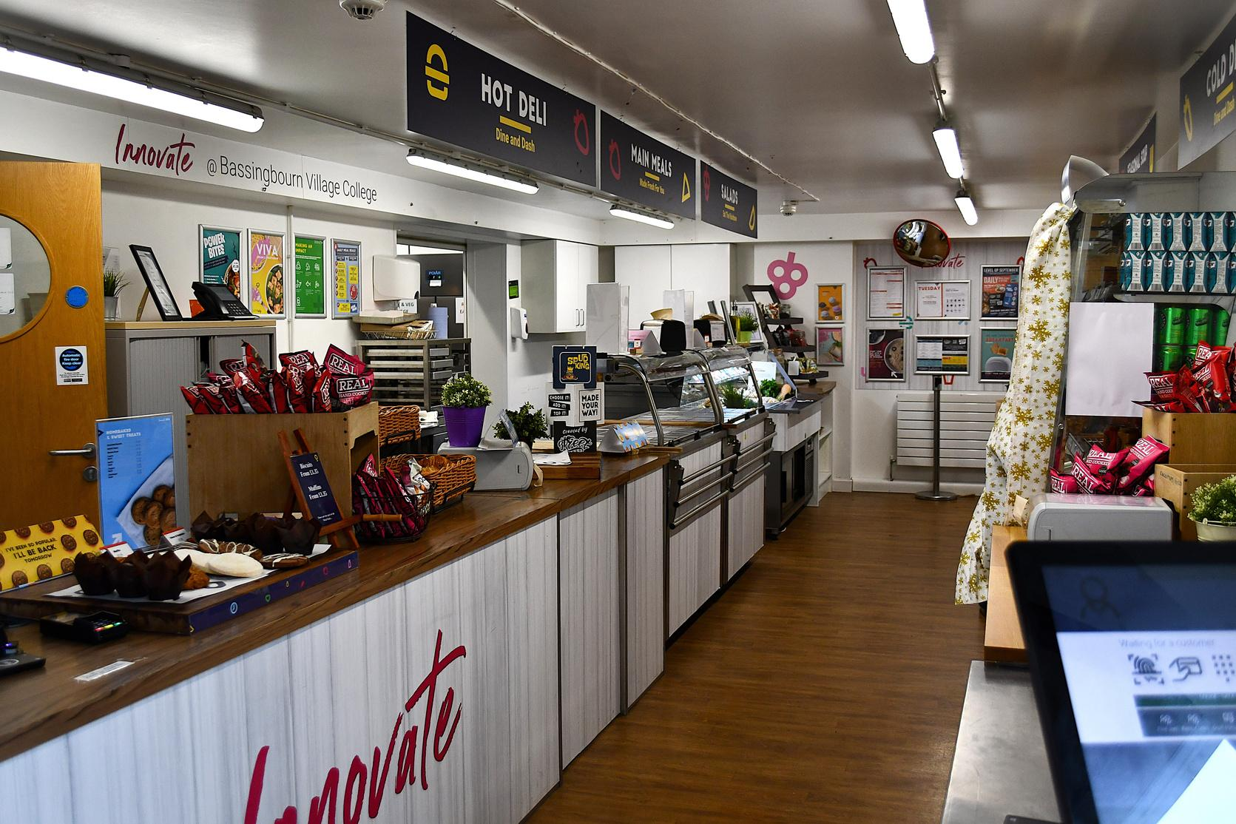
Respect
Resilience
Responsibility
Free School Meals
To qualify for Free School Meals for your child / children you must be claiming one of the following benefits:
  Income Support
  Income Based Job Seekers Allowance
  Child Tax Credit only
  Guarantee element on State Pension
However, if you receive Working Tax Credits you are NOT entitled to free School lunches.
Parents will need to reapply annually for FSM from 1st August 2026.

Slide 18

Respect
Resilience
Responsibility
School Details
Phone number:
  01763 242344
Website:
  www.bassingbournvc.org
Email:
  office@bassingbournvc.org
Absence email:
  absence@bassingbournvc.org

Slide 19

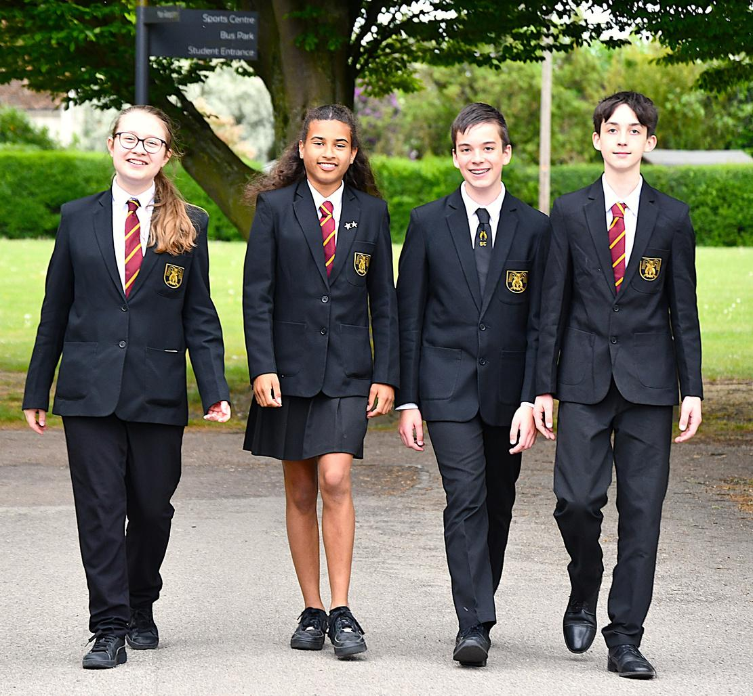
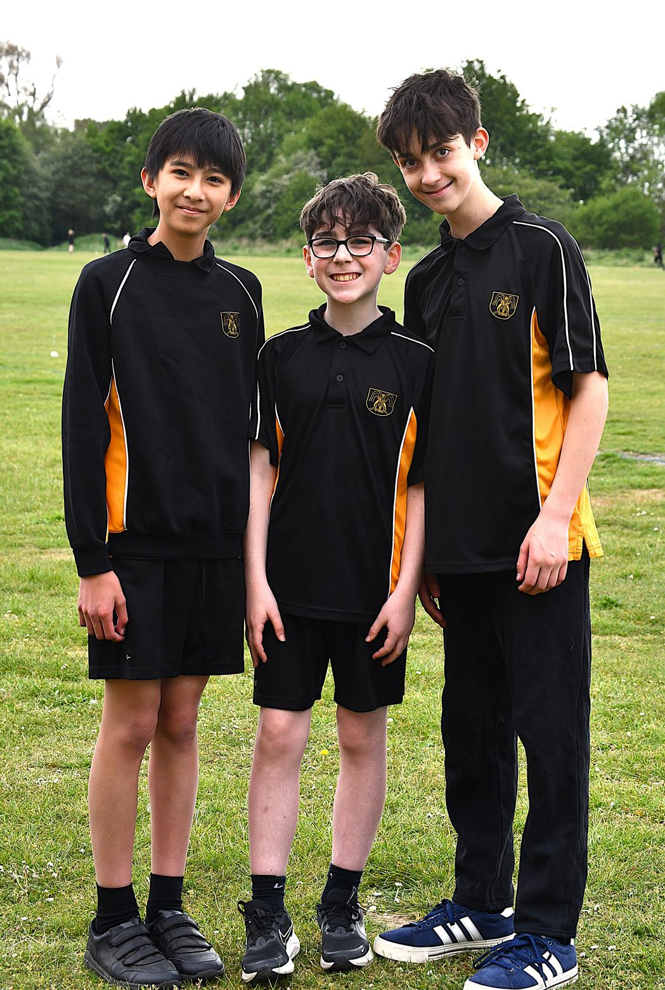

Respect
Resilience
Responsibility

